Slide 1
Election Seizure Management System
Presented by
Santosh Pathariya Head of Technology, ECI

Slide 2
Background
ECI committed to ensure inducement free elections
Extensive monitoring process starts month before the announcement of elections
ECI deploy Expenditure Observers in the state for strict vigil & monitoring
22+ agencies actively involved for election expenditure monitoring

Slide 3
Introduction
ESMS Developed by ECI for reporting seizure on real time basis
Successfully implemented in past 5 States assembly elections
Seven fold increase in seizures during last 5 States AC election in comparison to 2018 State Assembly elections
Ready to rollout in forthcoming GE to Lok Sabha

Slide 4
Objective
Digitize data for intercepted/Seized items (Cash/Liquor/Drugs/ Precious Metal/Freebies/Other Items) direct from field through Mobile App
Auto generation of report in prescribed format
Avoid duplicate data entry by Agencies
Analysis on received data at CEO Level

Slide 5
ESMS Users?
District Nodal
BANKS
State Nodal
DLBC
DEO
CEO
State Nodal
FST/SST
District Nodal

Slide 6
Seizure use case?
Intercept
FS/SST Team intercept, data entry in ESMS App, Inform concern officer and handover the intercepted items
Seizure
Intercepted Seizure
State Nodal/District nodal officers may search the entry in App, take appropriate action
Suo motu Seizure
State Nodal/District nodal officers directly data entry in App to seize

Slide 7
Agencies need to onboard?
01
State Police Department (SPD)
02
Income Tax Department
03
State Excise Department
04
Central Goods and Services Tax
State Goods and Services Tax/Commercial Tax
05

Slide 8
Agencies need to onboard?
06
Directorate of Revenue Intelligence
07
Directorate of Enforcement
08
Narcotics Control Bureau
09
Border Security Force
Sashastra Seema Bal
10

Slide 9
Agencies need to onboard?
11
Indo-Tibetan Border Police
12
Central Industrial Security Force
13
Assam Rifles
14
Indian Coast Guard
Railway Protection Force
15

Slide 10
Agencies need to onboard?
16
Department of Post
17
Forest Department
18
Airport Authority of India
19
State Civil Aviation Department
Bureau of Civil Aviation Security
20

Slide 11
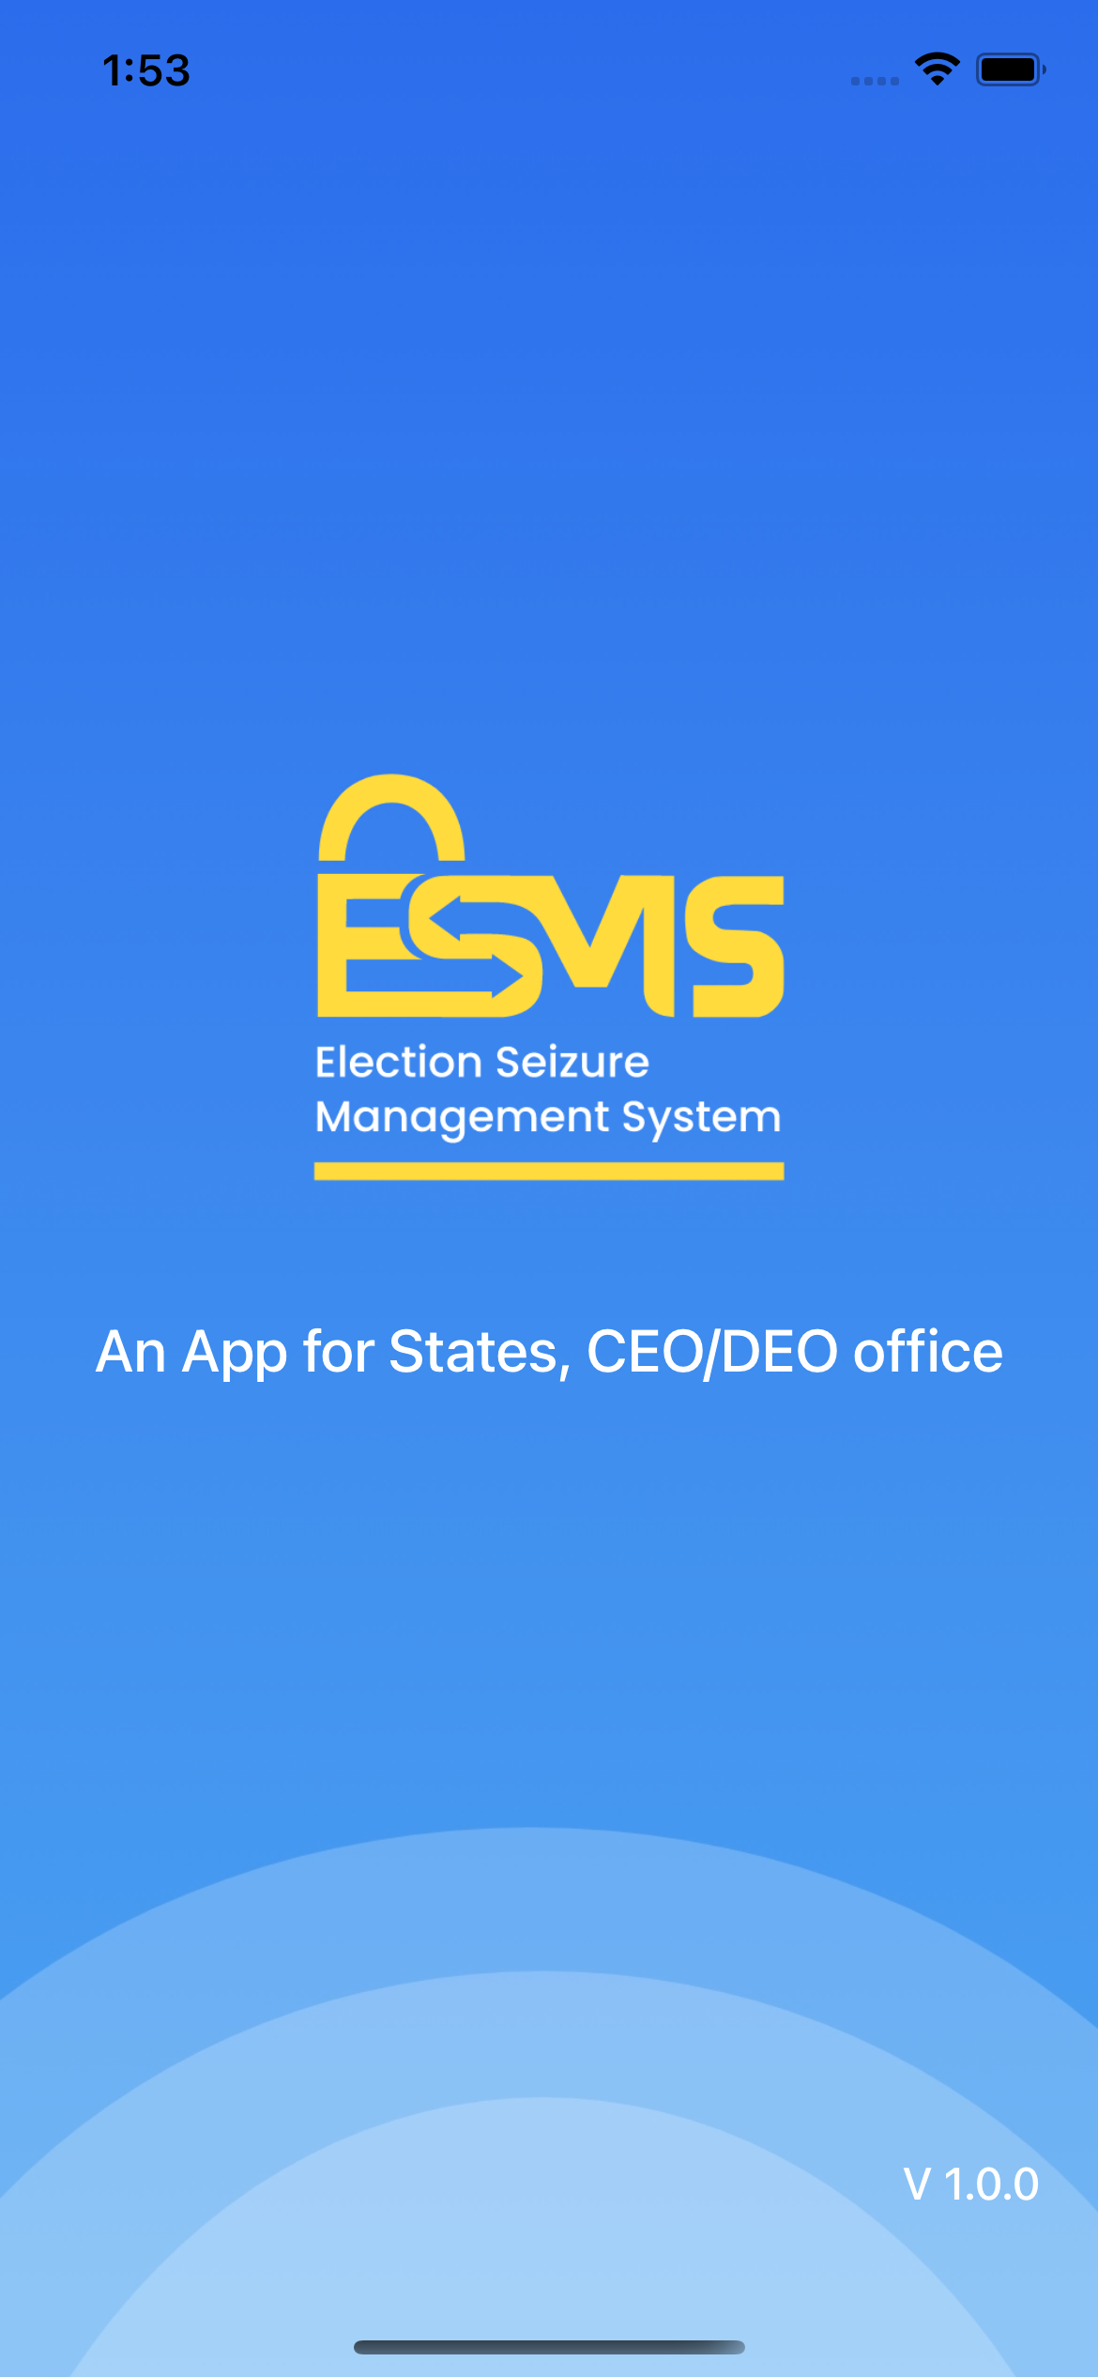
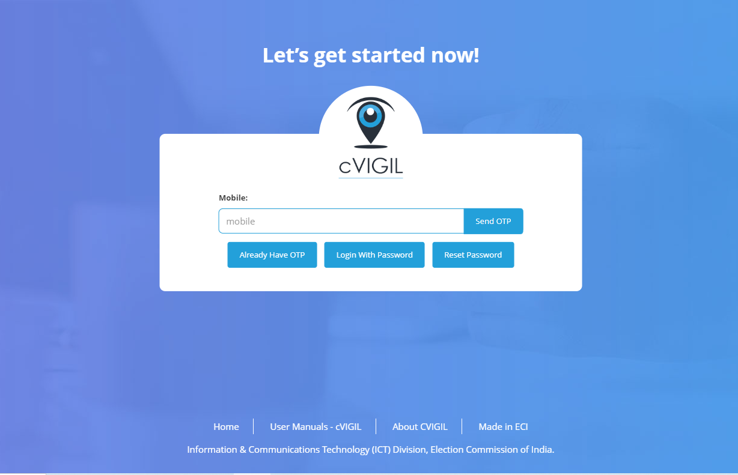
ESMS Components
https://cvigil.eci.gov.in/

Slide 12
ESMS Components
Web Application
For User onboarding (State Nodal/District Nodal/FST/DLBC/Banks)
View/Download reports with drill down option up to AC level
Data entry by District Nodal for respective agency
Issue Cash transfer letter (QR Code)
Mobile App (Android & iOS will be available on Play Store/App Store)
Data entry for Intercept/Suo Motu Seizure and claim for Intercepted Seizure
Show Analytics with limited scope

Slide 13
Access of Portal/ESMS Mobile App?
CEO/ DEO/DLBC/ Banks
State Nodal
District Nodal
FS/ SST
ESMS Mobile App
cVIGIL Portal

Slide 14
Data entry process for Intercept?
FS/SST or District Nodal will login with registered mobile number in ESMS mobile App
Data entry for Intercept through App
Intercept entry will be visible to all District Nodal for all agencies
Seized entry will be reflected in Portal
District Nodal will seize the intercept entry from App after receiving the items
FS/SST/DN will handover the intercepted items to concern agency

Slide 15
Data entry process for Agency Seizure?
District Nodal will login with registered mobile number in ESMS mobile App
Data entry for Agency Seizure
Visible to State Nodal on their Mobile App
Seized entry will be reflected in Portal

Slide 16
CEO Responsibility?
Onboard State Nodal officer for each Agency
Create DEO account for each District (Part of cVIGIL)
Verify DEO account if already exists
Share Seizure report to ECI

Slide 17
DEO Responsibility?
Onboard FS/SSTs for each AC for ESMS
Onboard DLBC (District Level Bank Coordinator)

Slide 18
State Nodal officer Responsibility?
Onboard District Nodal for each district for their respective State
Review reports from Dashboard from Web Application https://cvigil.eci.gov.in/
Use ESMS App to do data entry for seize/Intercept

Slide 19
District Nodal officer Responsibility?
Download/Install ESMS App from Google Play Store/Apple App Store
Use ESMS App to do data entry for seize/Intercept
View/Search Intercept entry done by FS/SST
View analytics for their district in App (Intercepted VS Seize)

Slide 20
Agency user onboarding process?
CEO office will onboard State level Nodal officer for each Agency
State level Nodal Officer may further create District nodal users for their respective Agency in cascade manner with multiple districts mapping
DEO will onboard FS/SSTs at AC Level
DEO will onboard DLBC (District Level Bank Coordinator)
DLBC will onboard Banks

Slide 21
User Onboarding process
CEO
State Nodal
District Nodal
DEO
FS/SST
DLBC
Banks

Slide 22
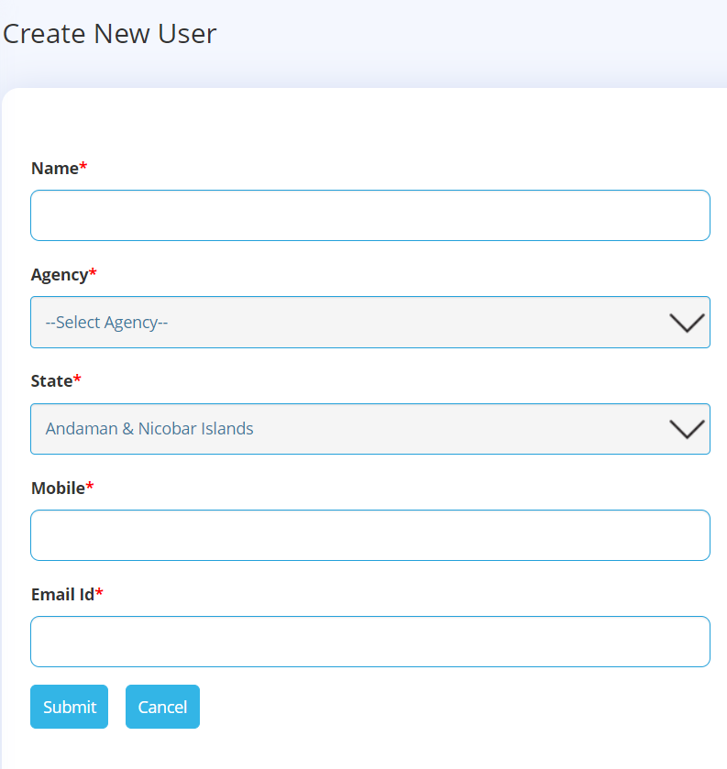
User onboarding (State Nodal) by CEO
Required fields for Onboarding
Name of Nodal Officer
Agency Name
State
Mobile
Email ID

Slide 23
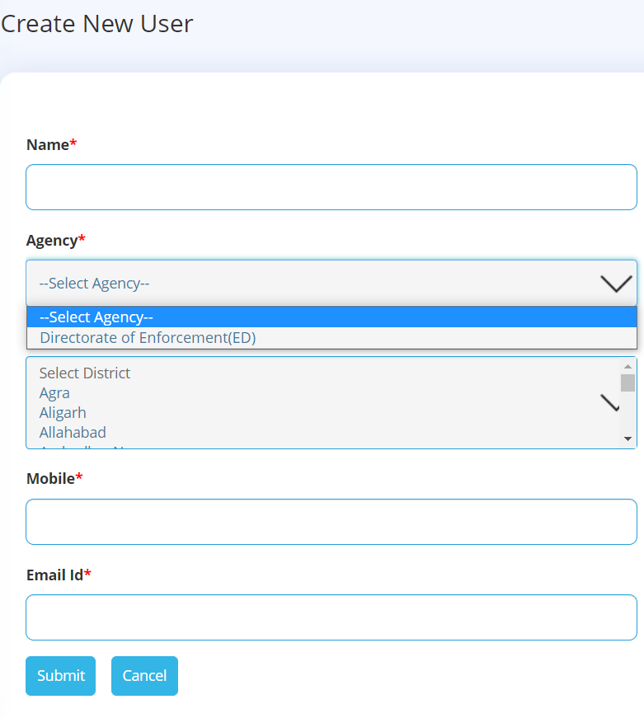
User onboarding (District Nodal) by State Nodal
Required fields for Onboarding
Name of Nodal Officer
Agency Name
District (Multi selection)
Mobile
Email ID

Slide 24
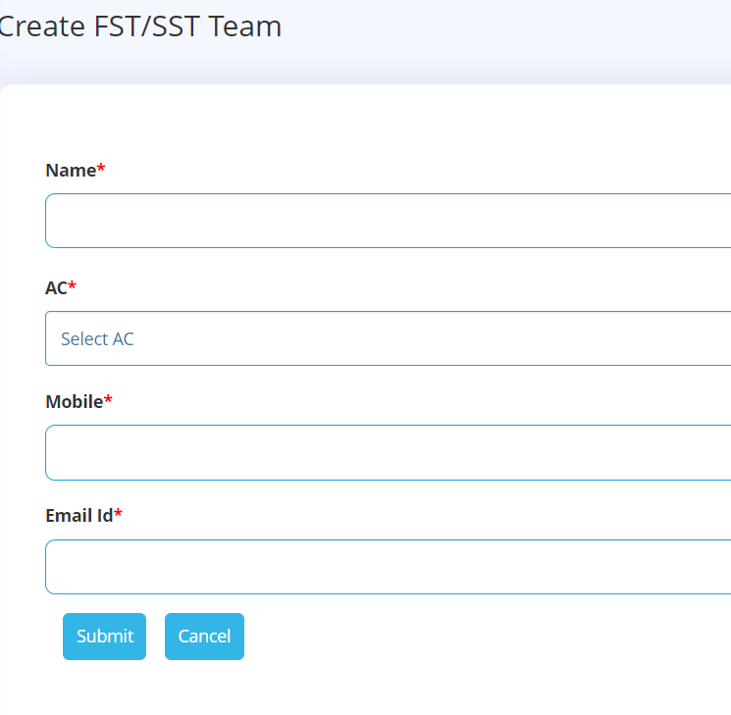
User onboarding (FST) by DEO
Required fields for Onboarding
Name of FST
AC Name
Mobile
Email ID

Slide 25
User onboarding (DLBC) by DEO
Required fields for Onboarding
Employee Name
Bank Name
Mobile
Email ID

Slide 26
Cash transfer use case
DLBC
BANKS
Validate
Intercept
Onboard all banks for their respective Districts
Generate Receipt with QR code for all cash movement
FS/SST/DN/SN may scan the QR code and validate the transfer
Intercept/Seize the cash if quantity mismatched from the receipt

Slide 27
How to access Application?
Web Application : https://cvigil.eci.gov.in
Mobile App (Google Play Store/Apple App Store)

Slide 28
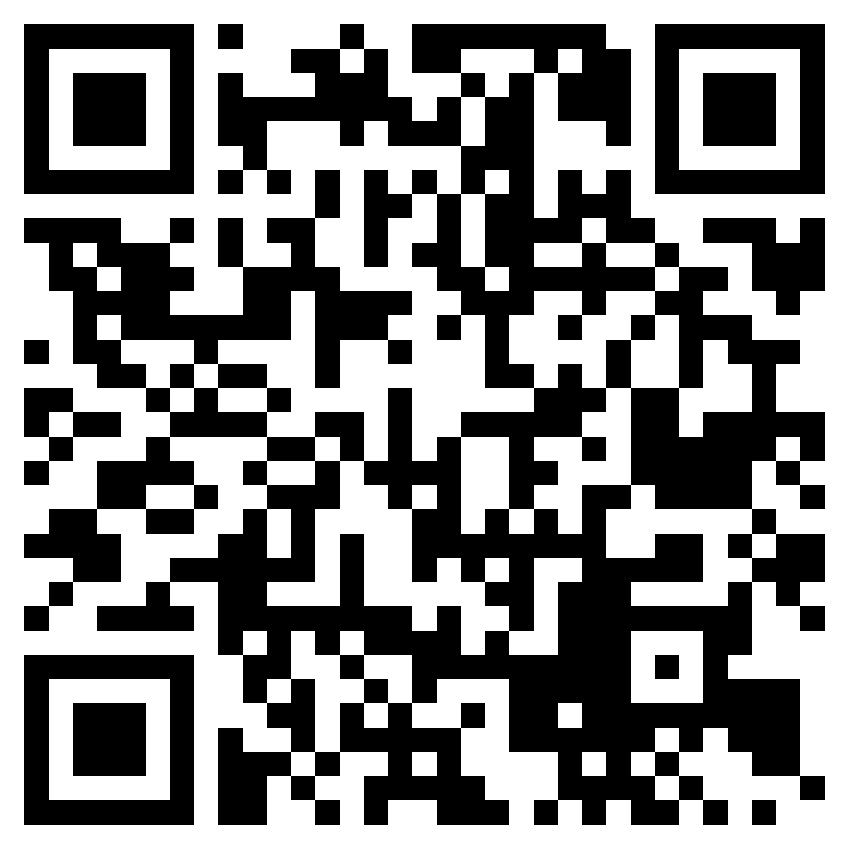
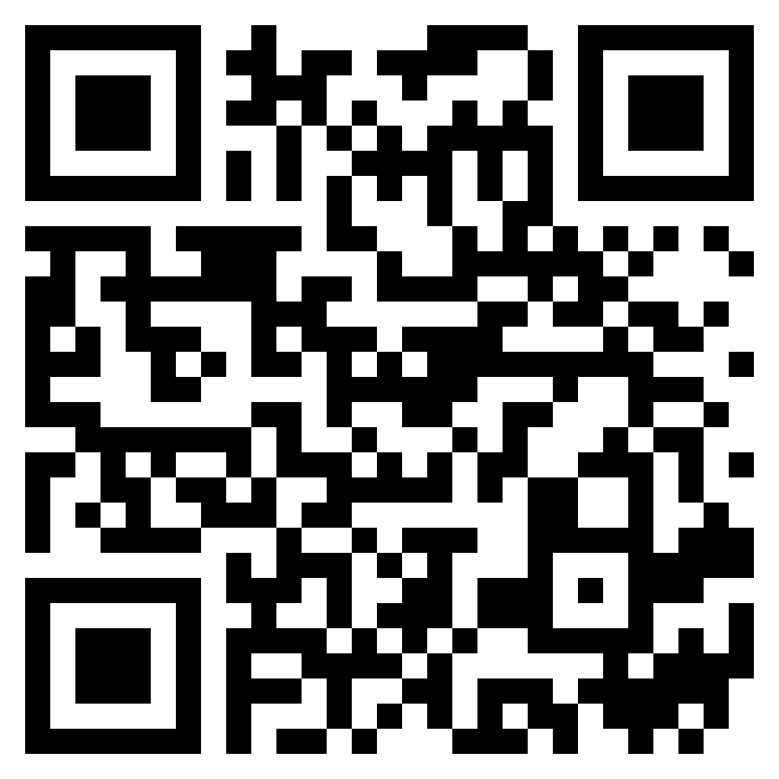
ESMS App
Android
iOS

Slide 29
Role & Permission
Role | User onboarding | Intercept | Seize | Suo Motu Seizure | Edit Approval | View Reports | Generate Receipt
CEO
DEO
State Level Nodal
District Nodal
FS/SST
DLBC
Banks

Slide 30
Rules for System
FS/SST/District Nodal may edit their records on same day
Any modification in Previous day records are not allowed for any user however user may request to CEO to allow edit, CEO office need to put remarks if approved
During Intercepted Seizure, User may not increase Qty/Amount however user may decrease Qty/Amount

Slide 31
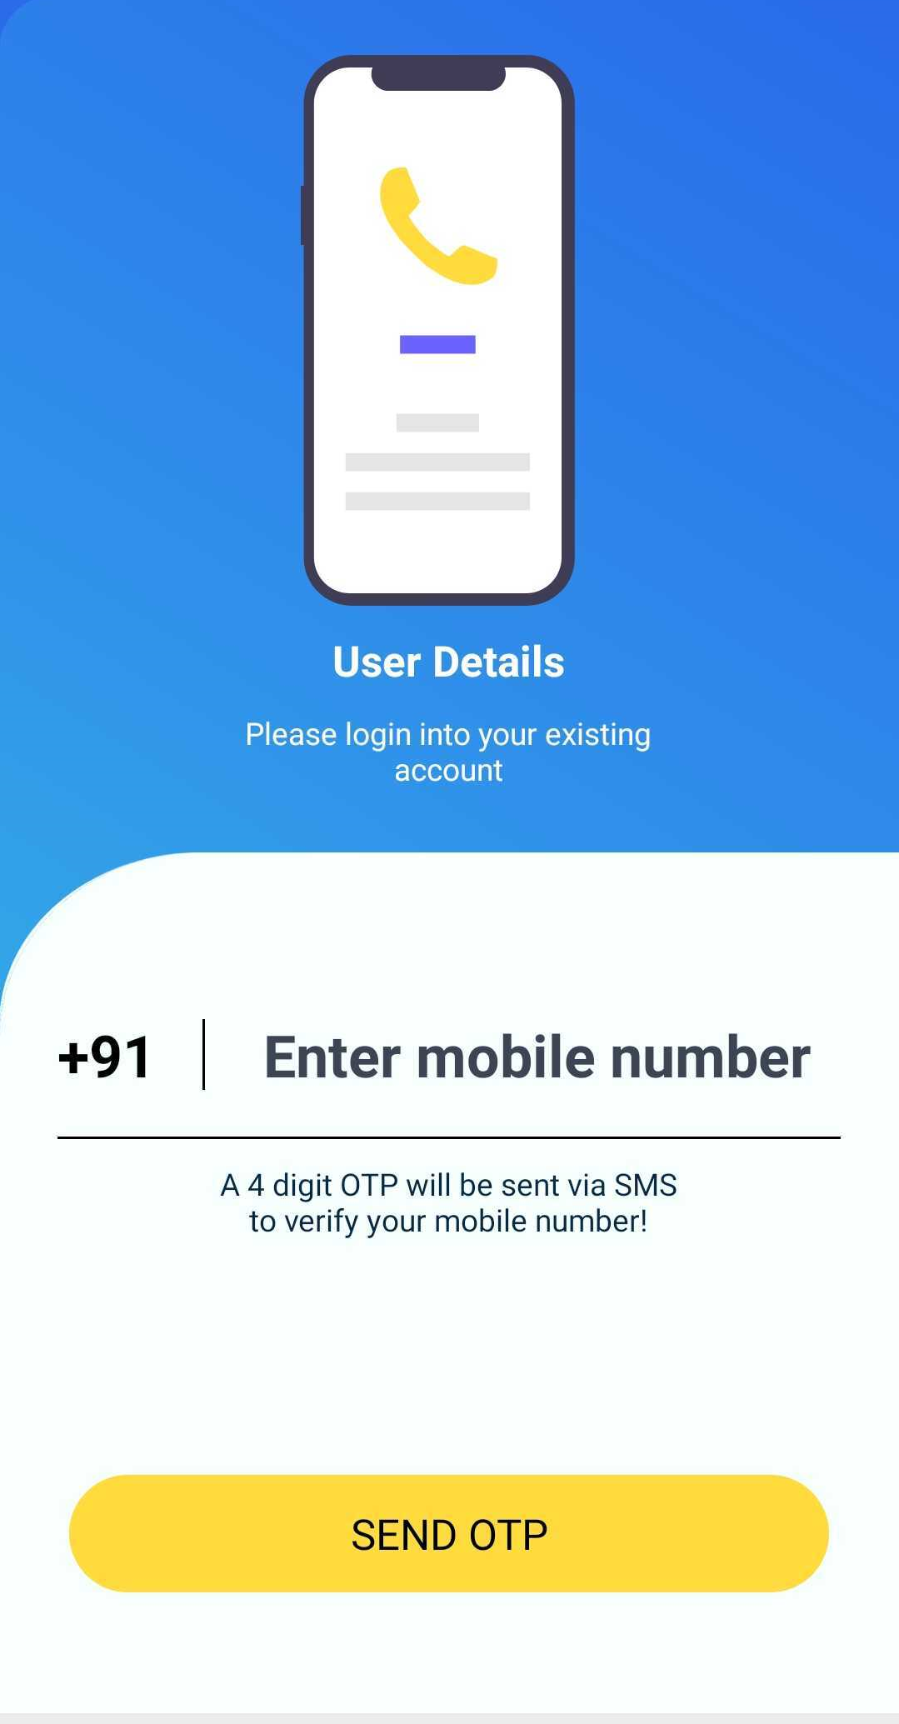
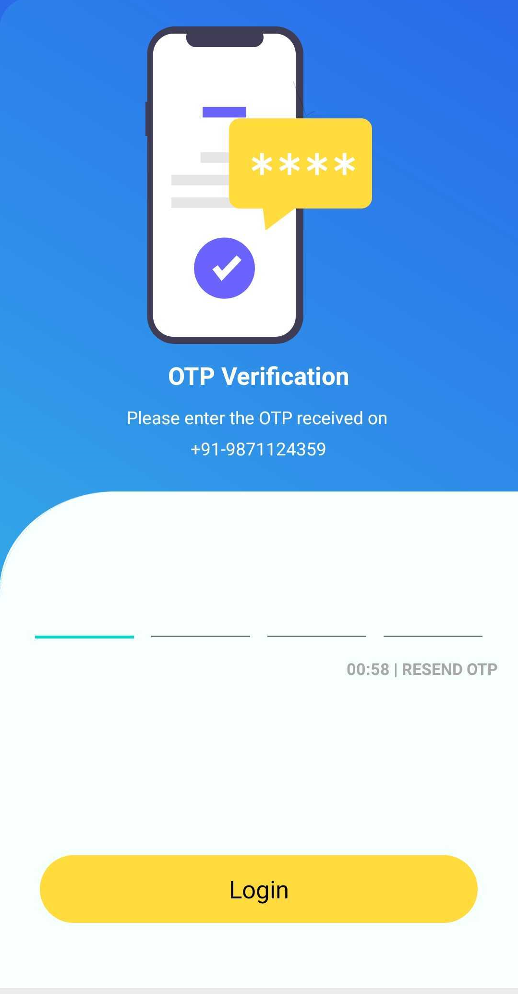
App Login Flow?

Slide 32
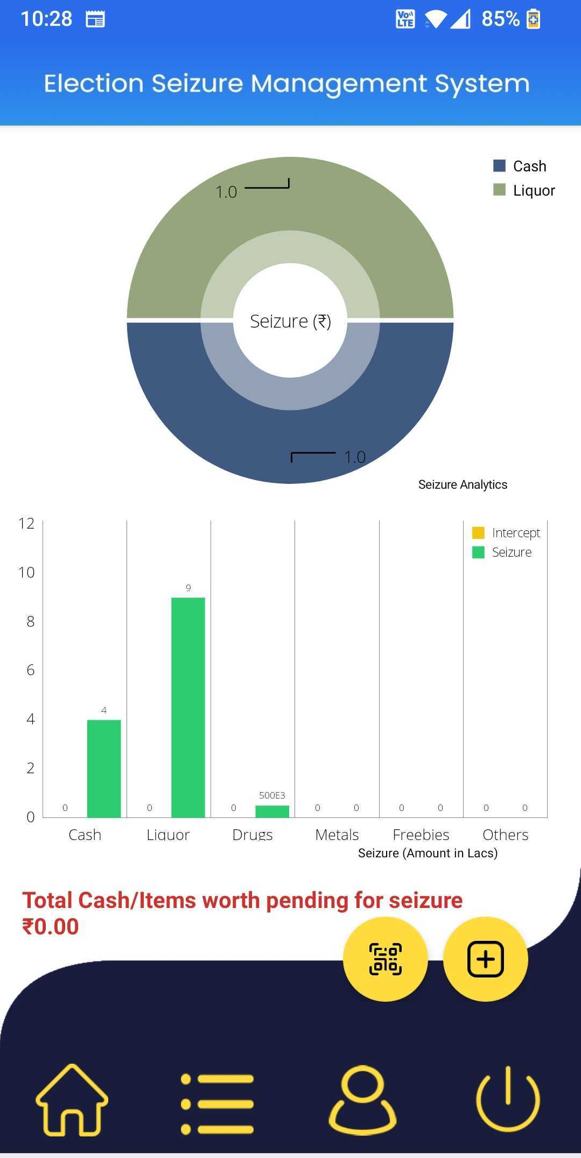
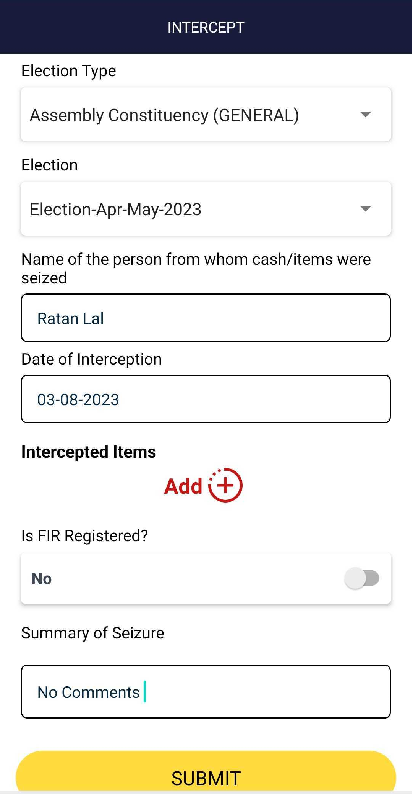
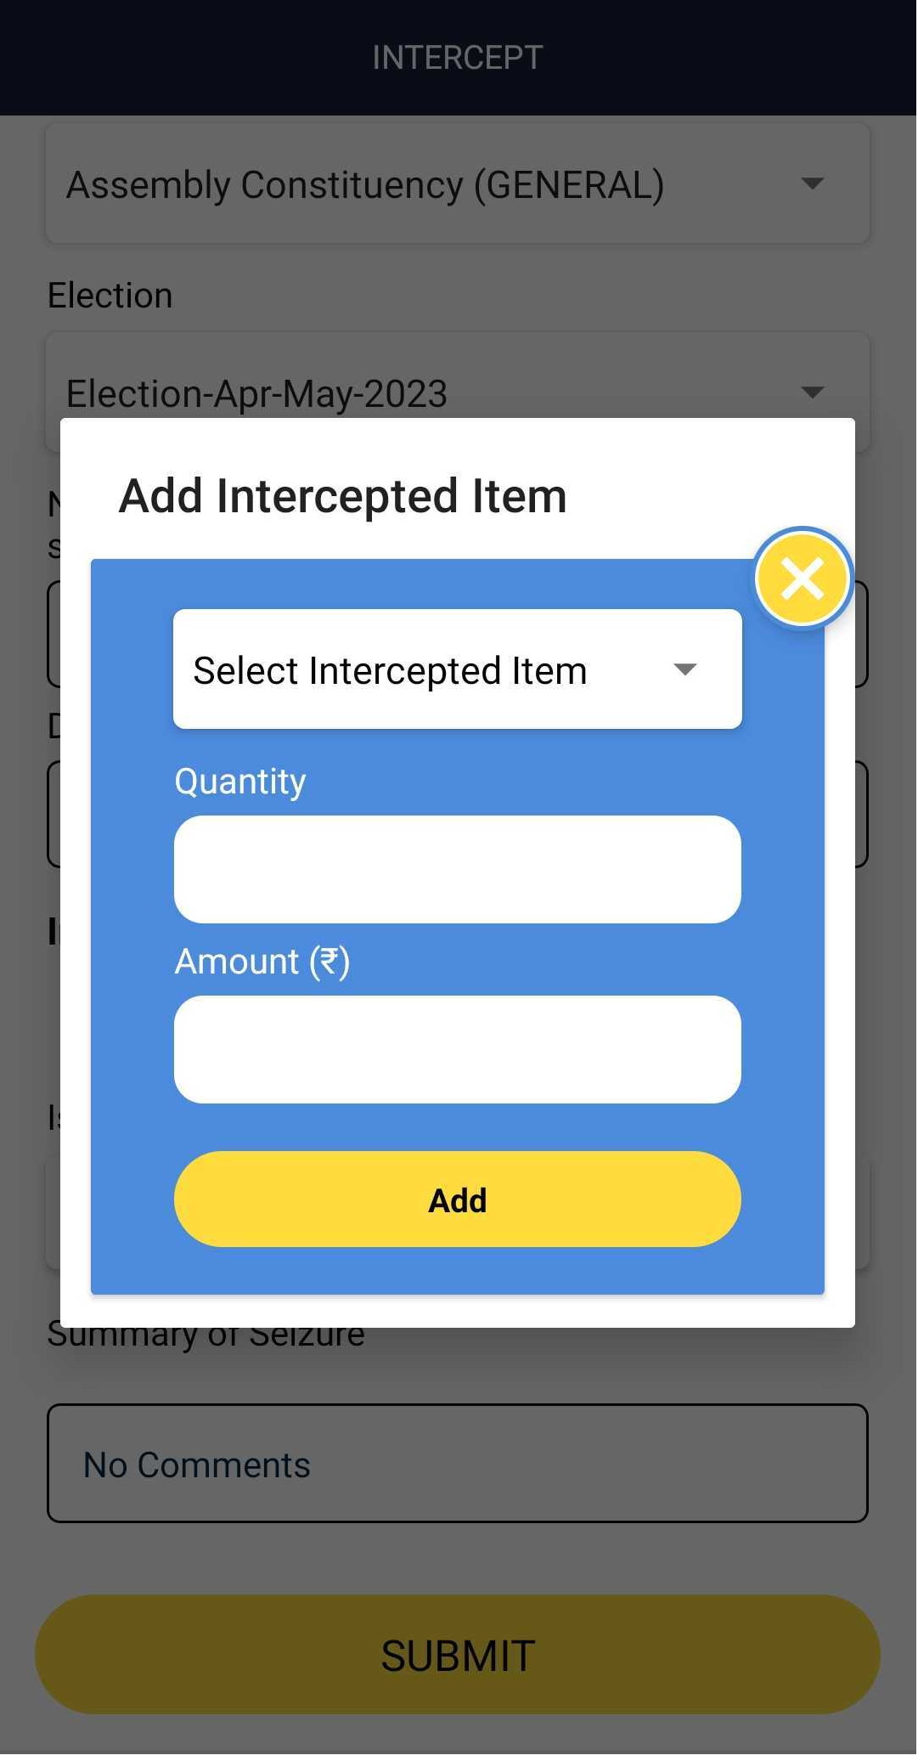
Intercept Flow?

Slide 33
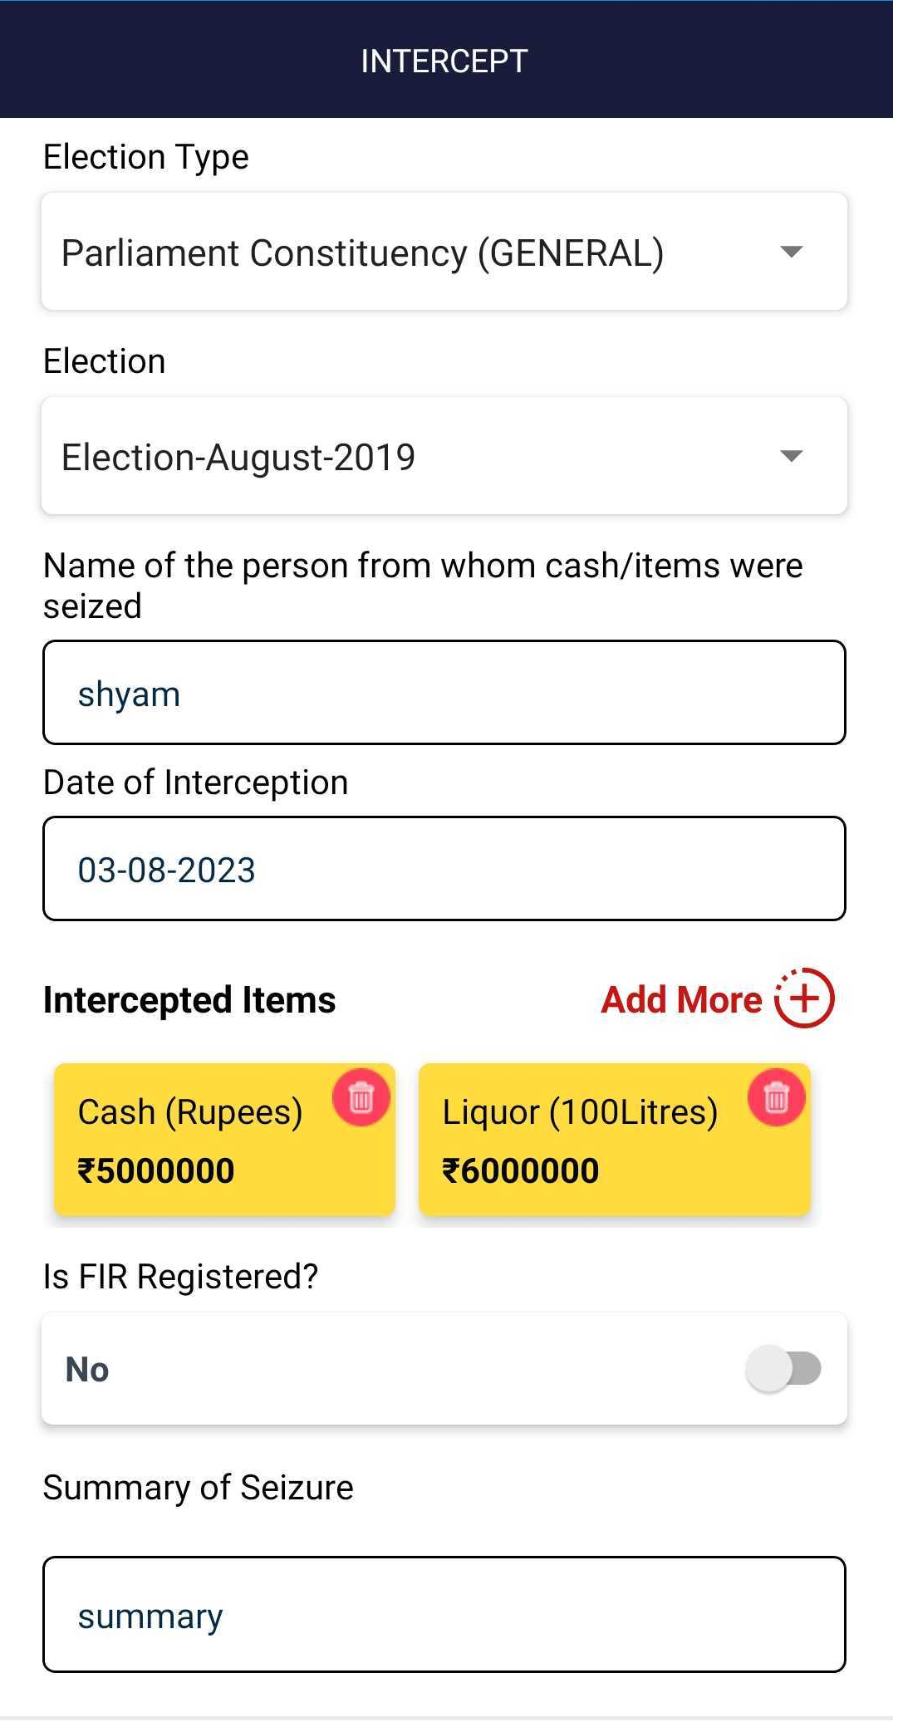
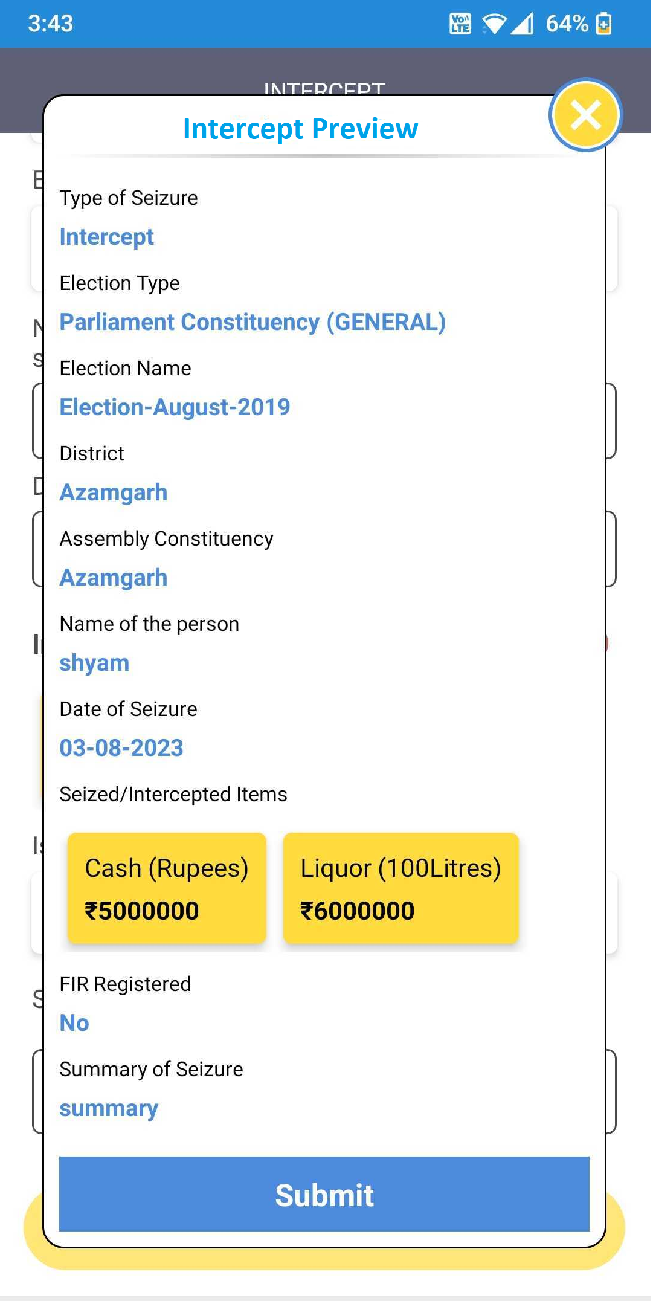
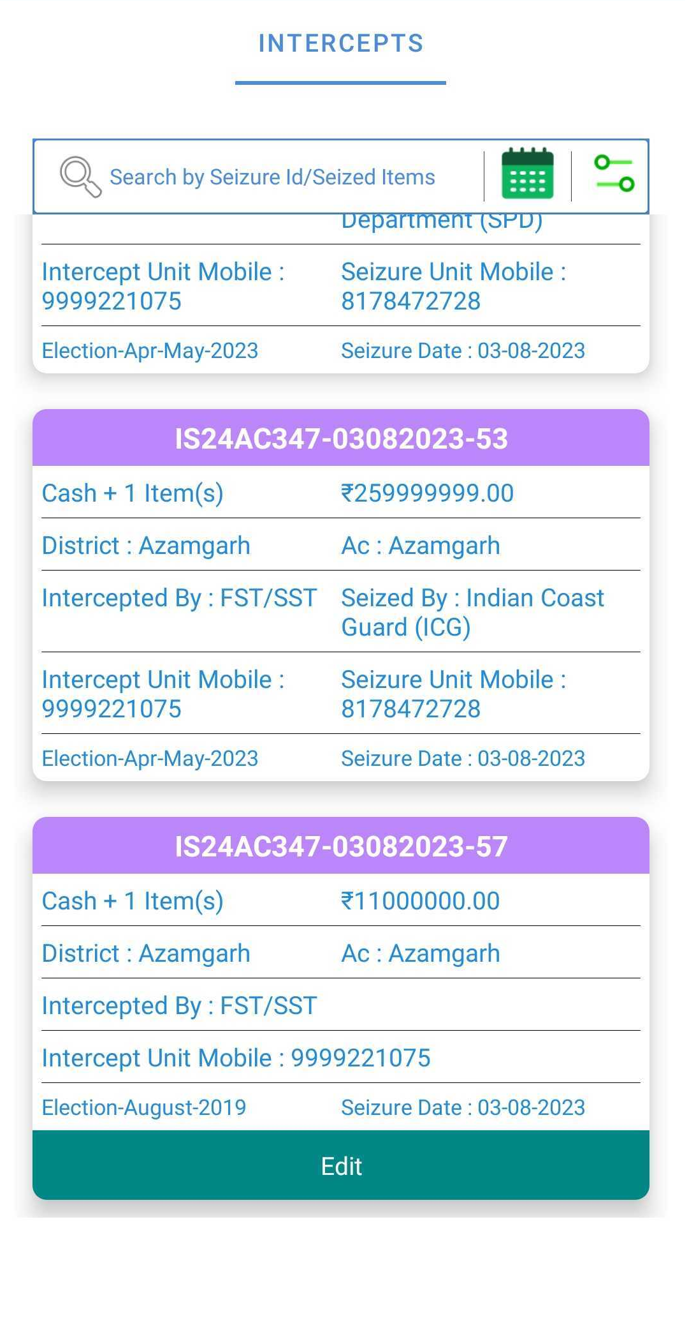
Intercept Flow?

Slide 34
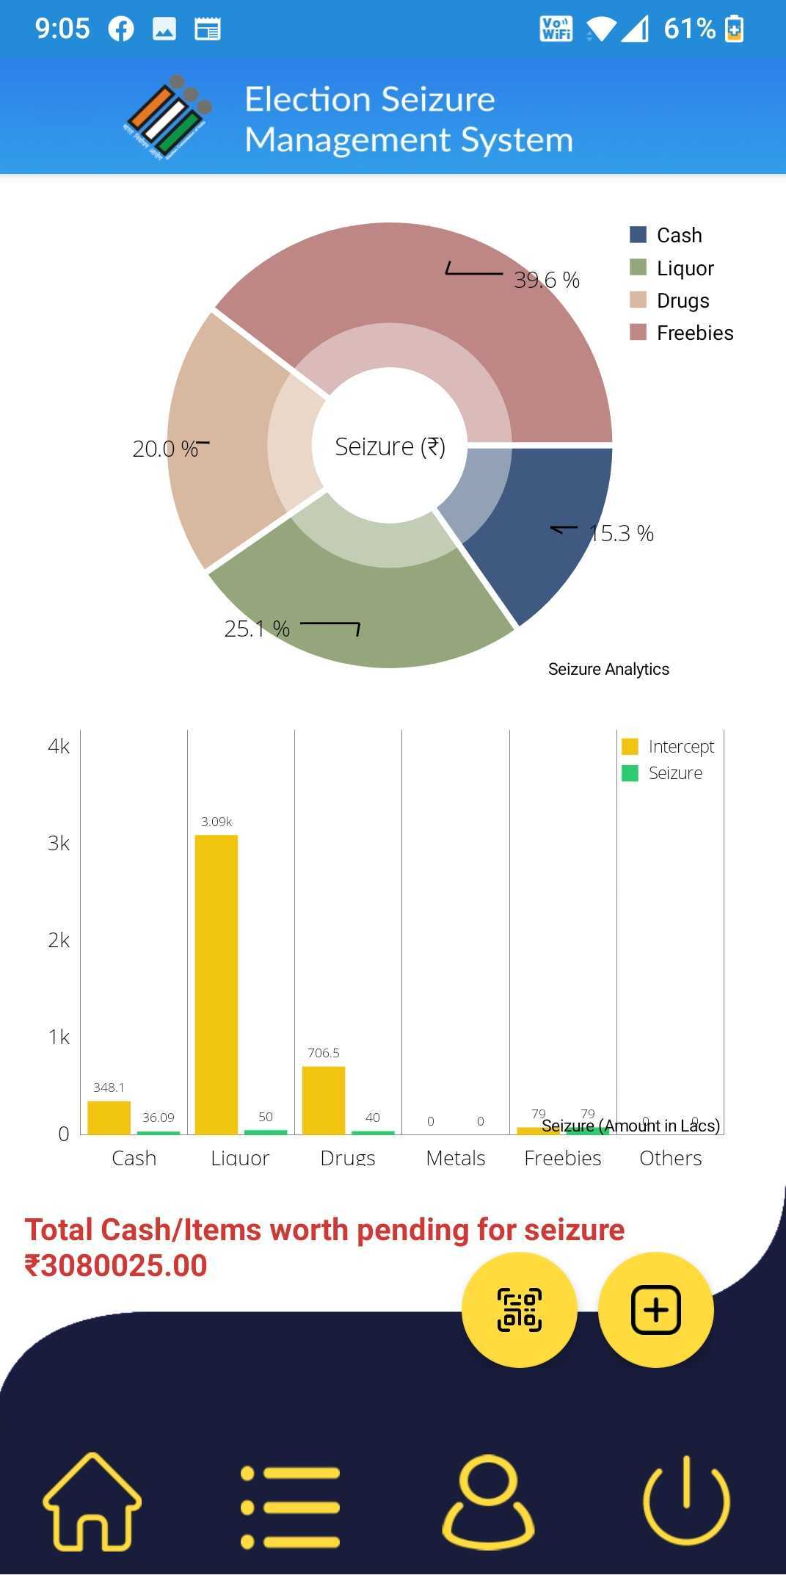
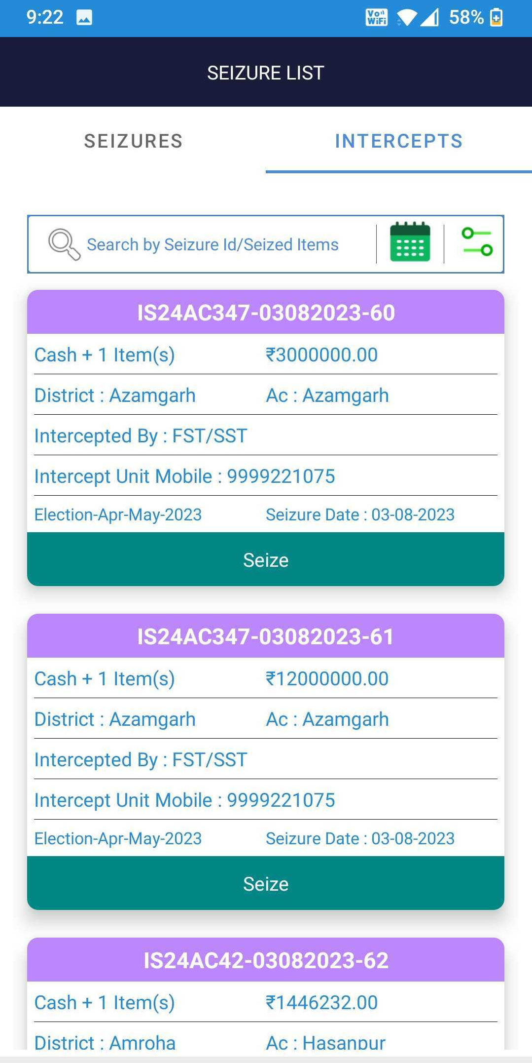
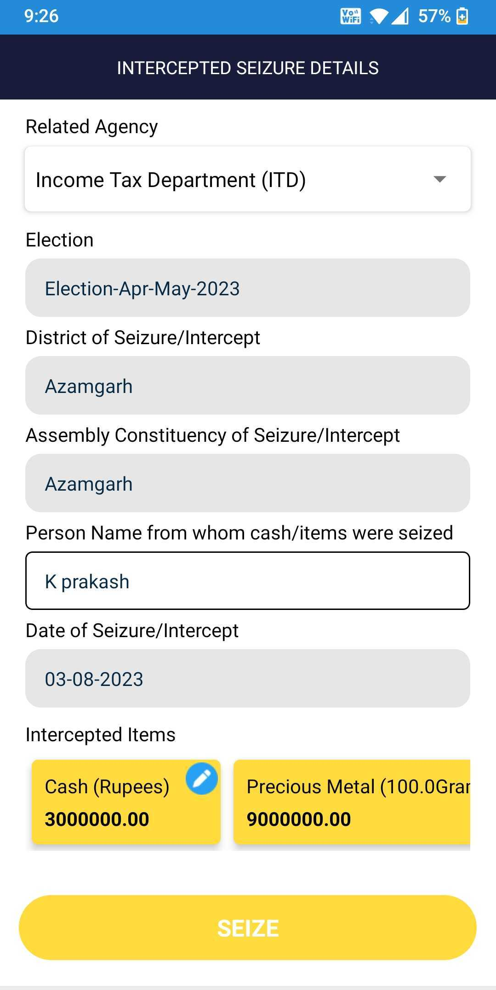
Seizure Flow?

Slide 35
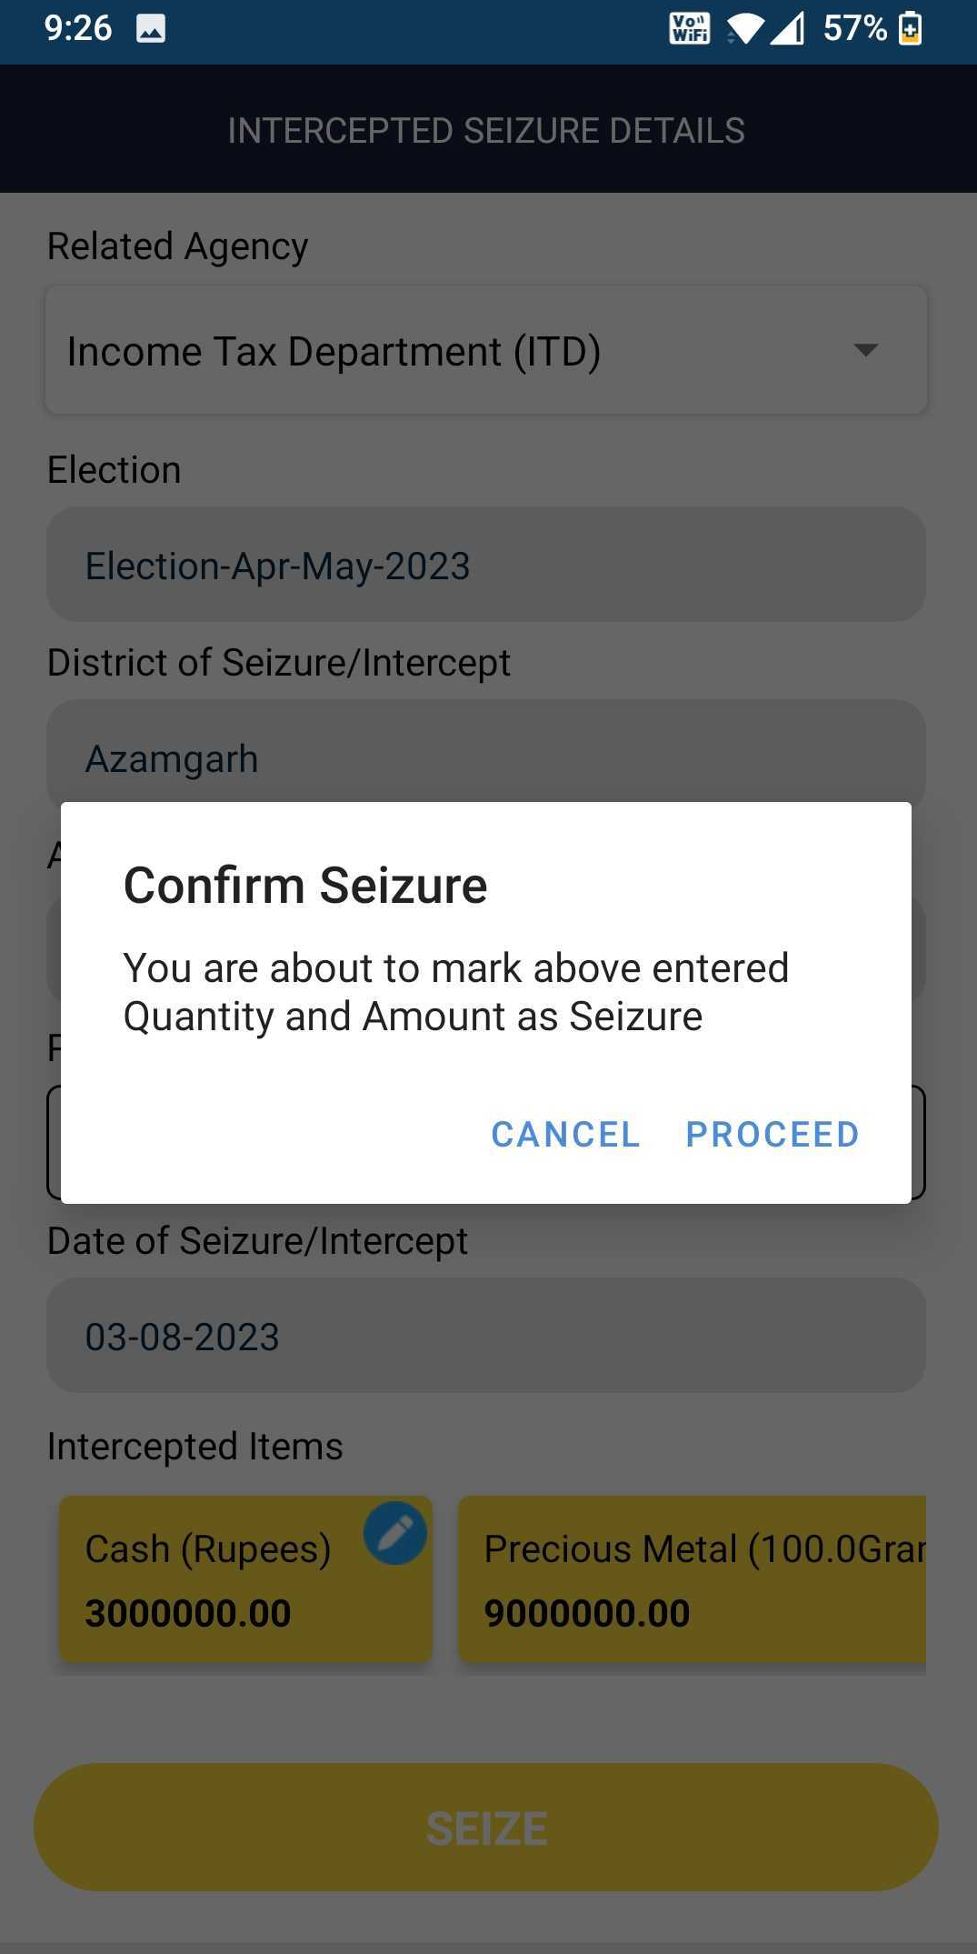
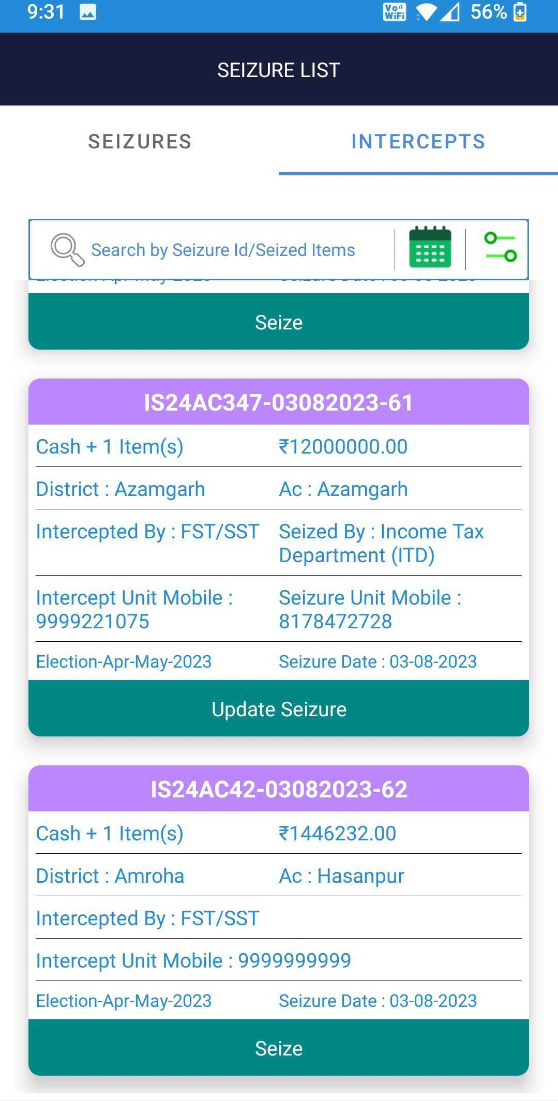
Seizure Flow?

Slide 36
Update criteria?
 | FS/SST | DN | SN
Intercept
Edit on same day but not Seized
Suo Motu Seize
Edit on same Day
Intercepted Seize
Edit on same Day
Seize
Request to edit to CEO

Slide 37
QR Code Receipt Generation
Required fields to Generate QR
Vehicle No
From Date
Valid till Date
Driver Name
Driver Identification
Contact Person/Mobile
Amount
Source Location
Destination Location

Slide 38
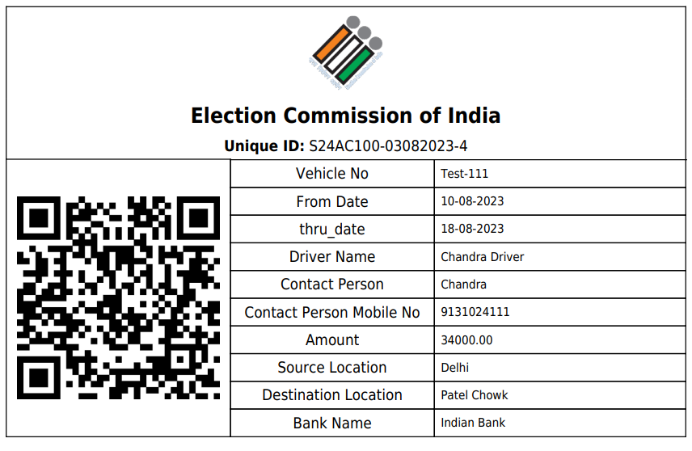
QR issued by Bank

Slide 39
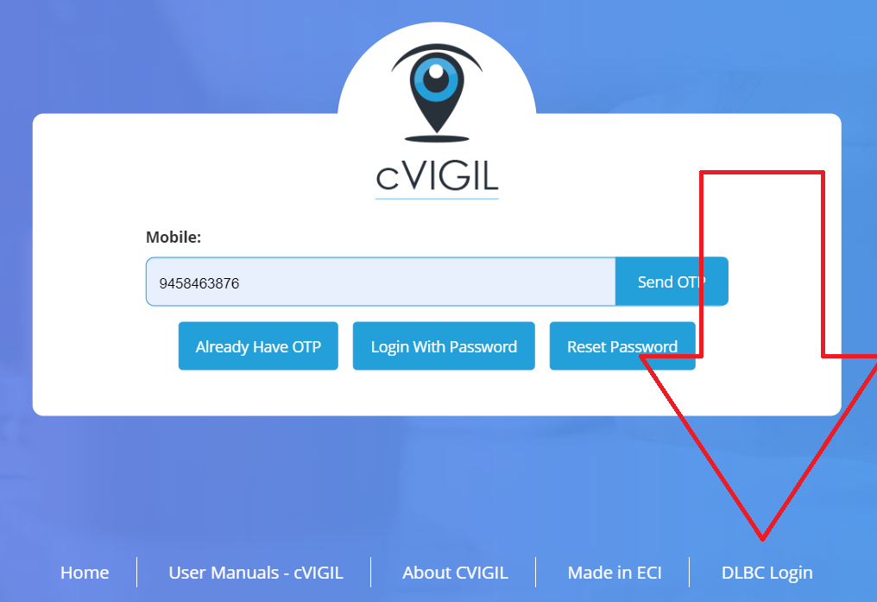
DLBC and Banks Login?
https://cvigil.eci.gov.in/bnk/login

Slide 40
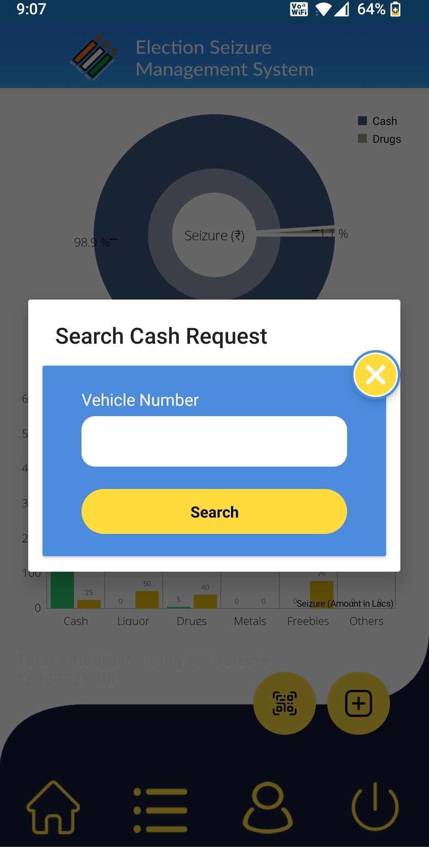
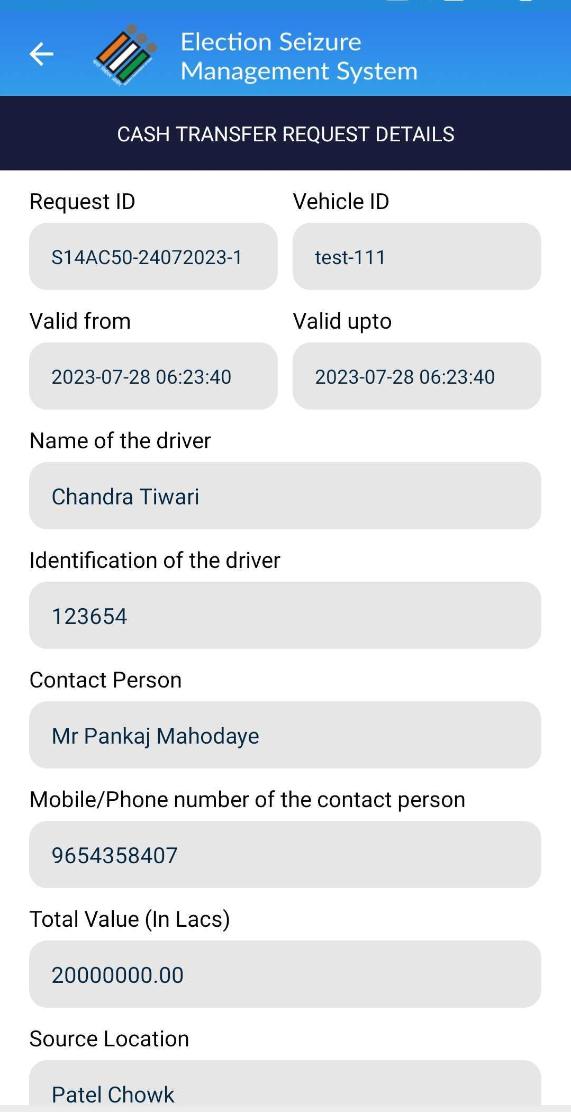
QR Scan process?

Slide 41
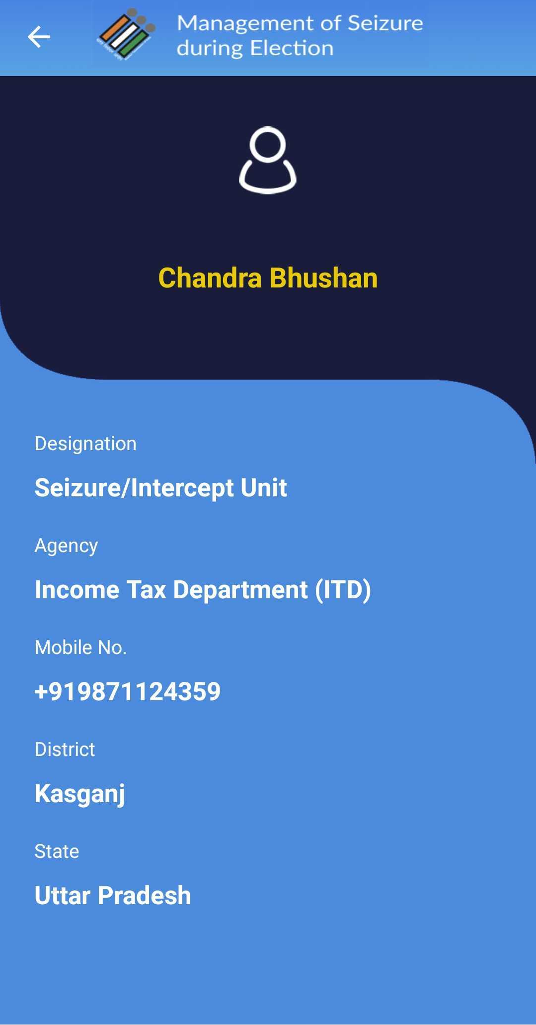
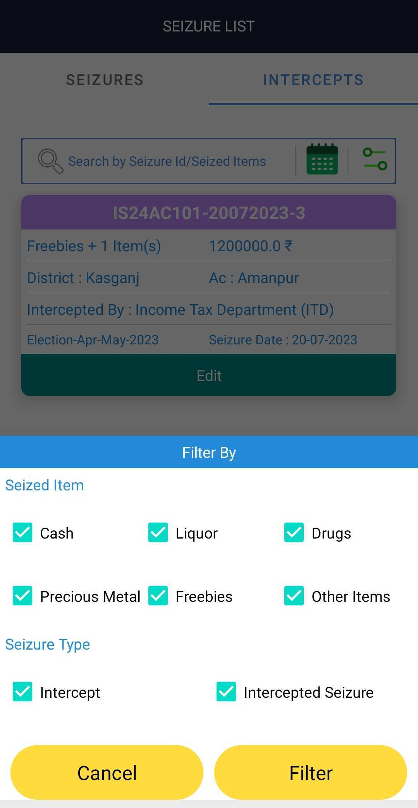
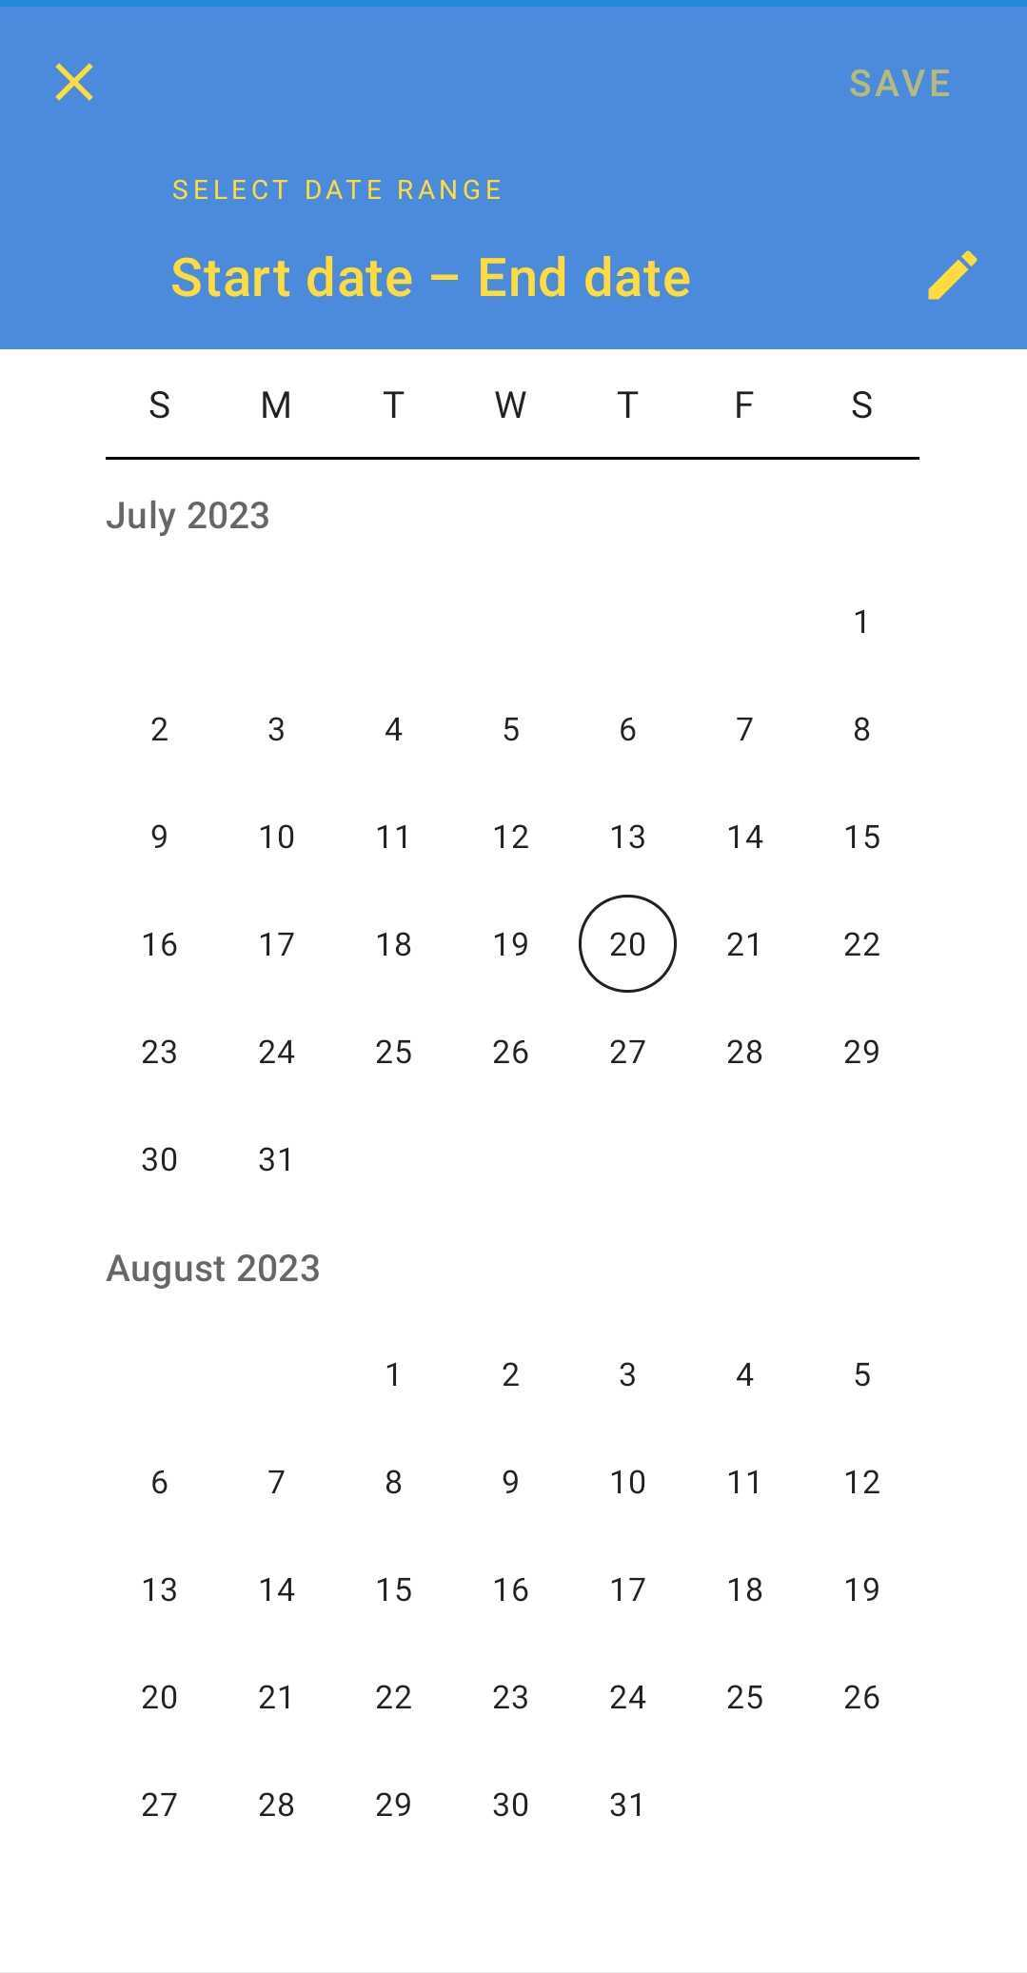
Profile/Search Filters

Slide 42
Reports
CEO Login
District Wise report
Agency wise report
AC wise report
DEO Login
AC Wise report
User Wise report
Top 10 FST/SST
State Nodal Login
District Wise report
User Wise report

Slide 43
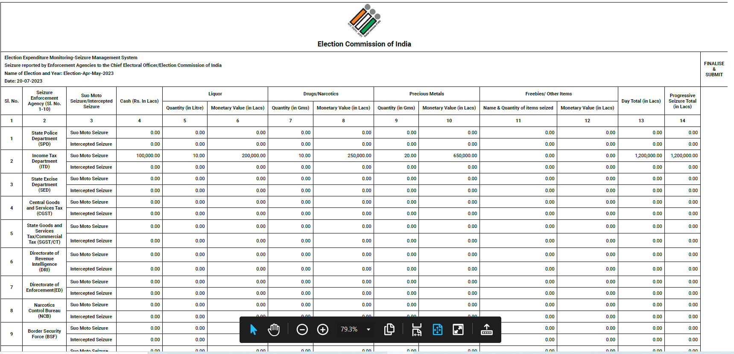
Report format

Slide 44
Statistics Past Election (AC General Elections)

Slide 45
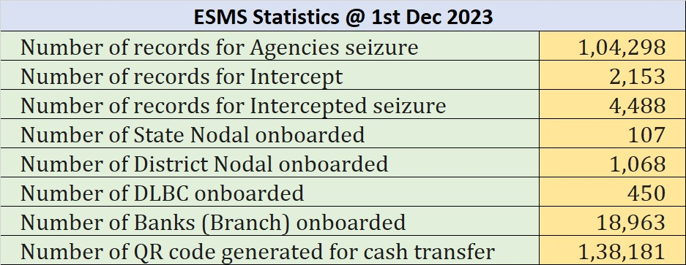

Slide 46
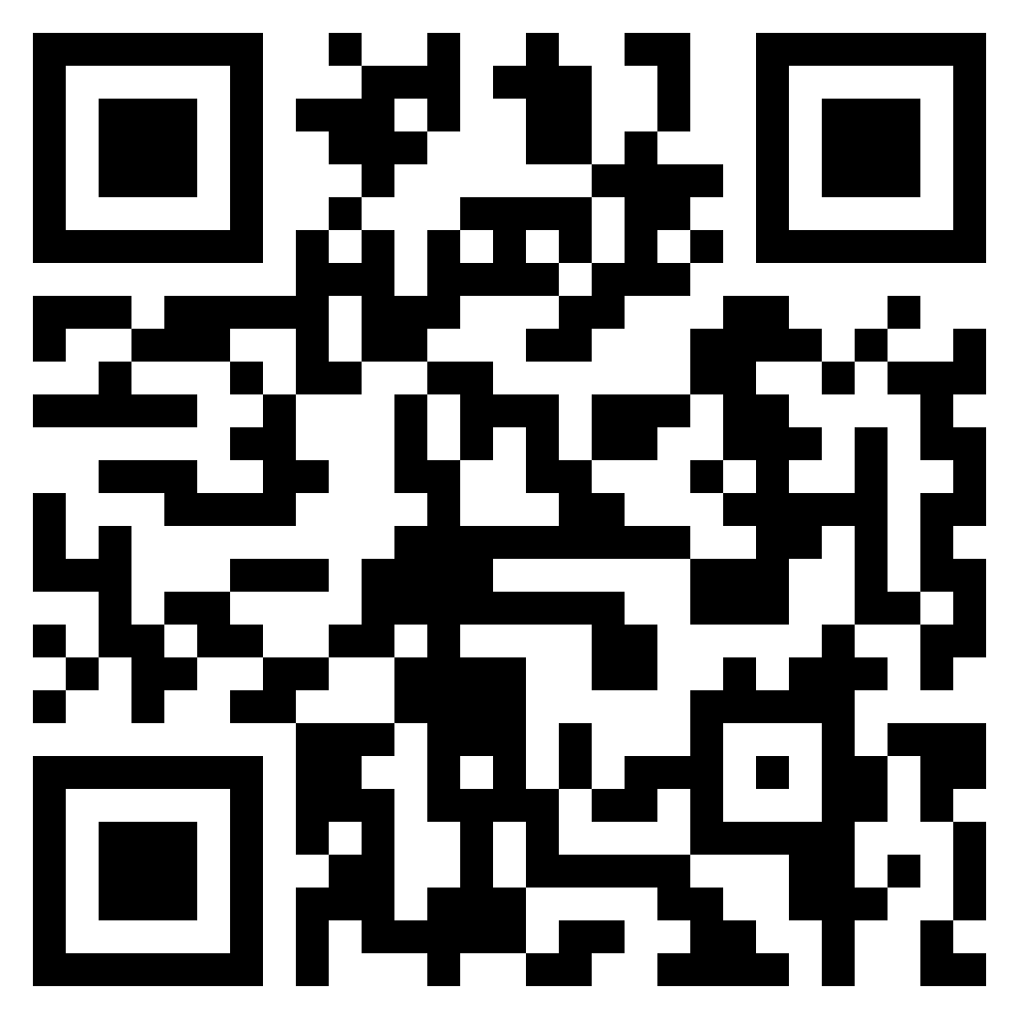
Join ESMS Support WhatsApp Group
https://chat.whatsapp.com/CITOXsTYASw5Omu1cD6lLX
WhatsApp : +91-8882377706

Slide 47
Q/A

Slide 48
Thanks!

